Slide 1
Shell Bootcamp 2024 – TECHNICAL FOUNDATION Reflections for Day 7 (06-Sep-2024)
Hitesh
Date : - 06-Sep-2024

Slide 2

My learnings from this week!

Slide 3
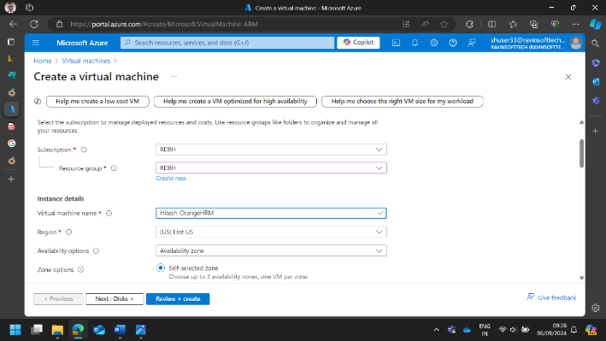
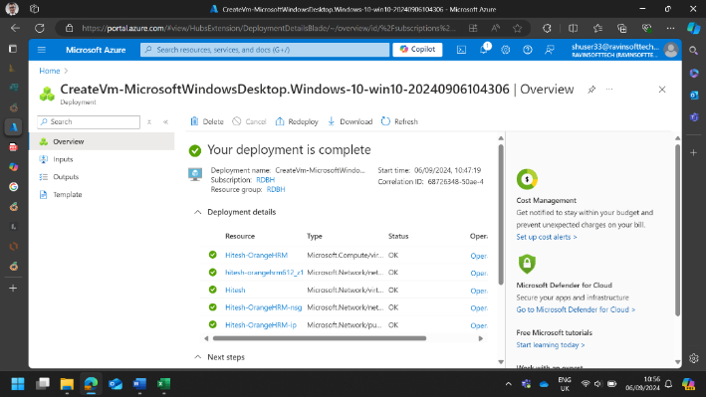
Learning 1 | My takeaways
Objective: Test concepts of SDLC, Agile, Software Testing, DBMS, and CI/CD pipeline using OrangeHRM website.
Creating Virtual Machine in Azure Portal

Slide 4
Learning 2 | My takeaways
SDLC, Agile, and Software Testing:
Azure Setup:
Created an Azure Virtual Machine (VM) to perform all tasks.
Logged into Azure DevOps and navigated to the project.
Sprint Management:
Created a new Sprint in Azure DevOps.
Set Sprint goals and objectives aligned with the overall testing strategy for the OrangeHRM website.
User Stories and Backlog:
Developed 5 User Stories covering different aspects of SDLC related to the website functionalities.
Added these stories to the Sprint Backlog.
Test Case Creation:
Created 25 test cases for the User Stories in the Sprint.
Task and Sub-Task Definition:
Defined tasks and sub-tasks for each User Story.
Manual Test Execution:
Executed all test cases manually focusing on functional testing.
Defect Reporting:
Generated Defect Reports for each failed or blocked test case.

Slide 5
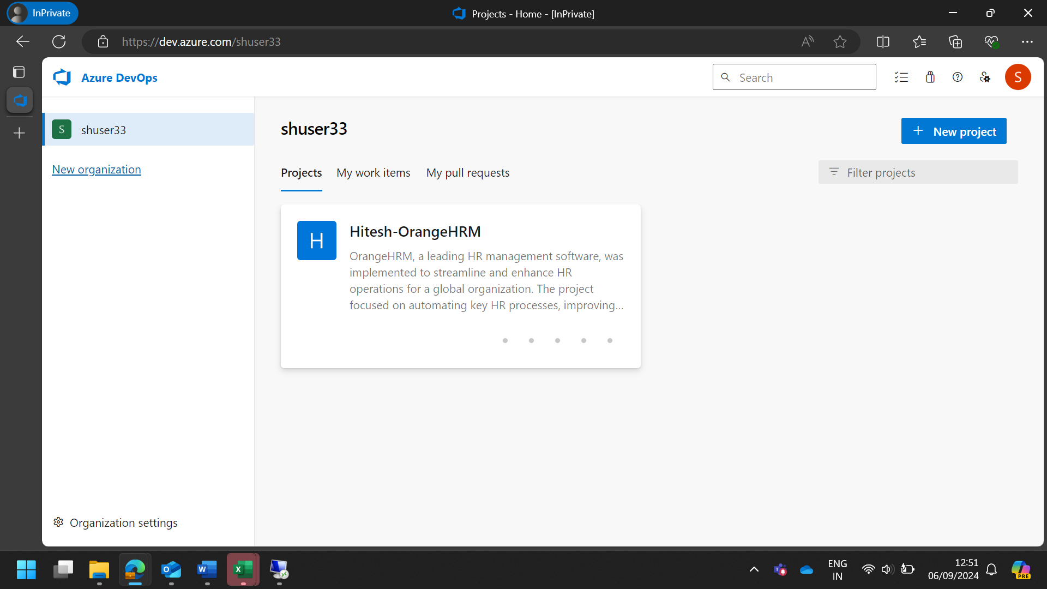
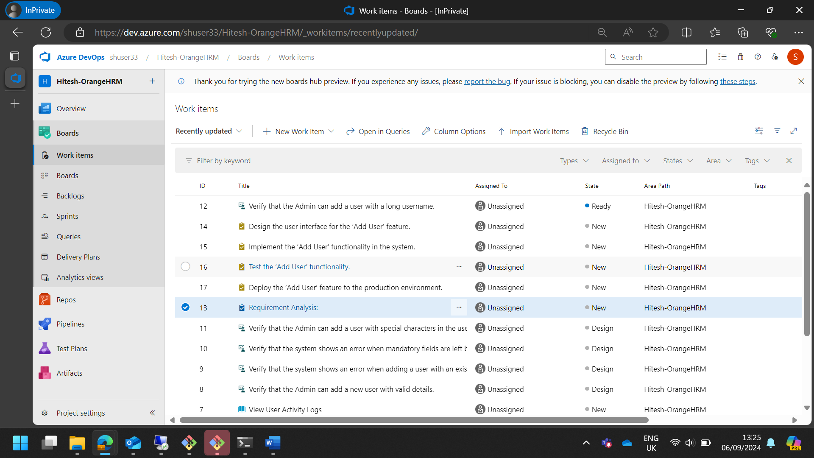
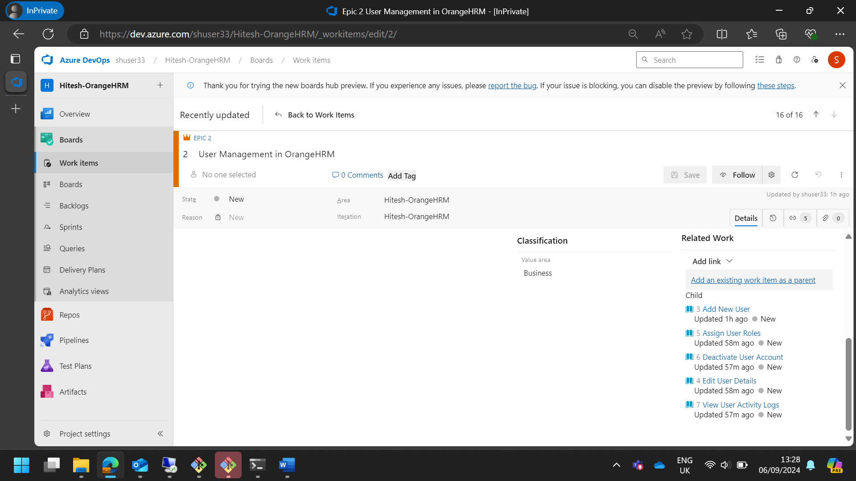
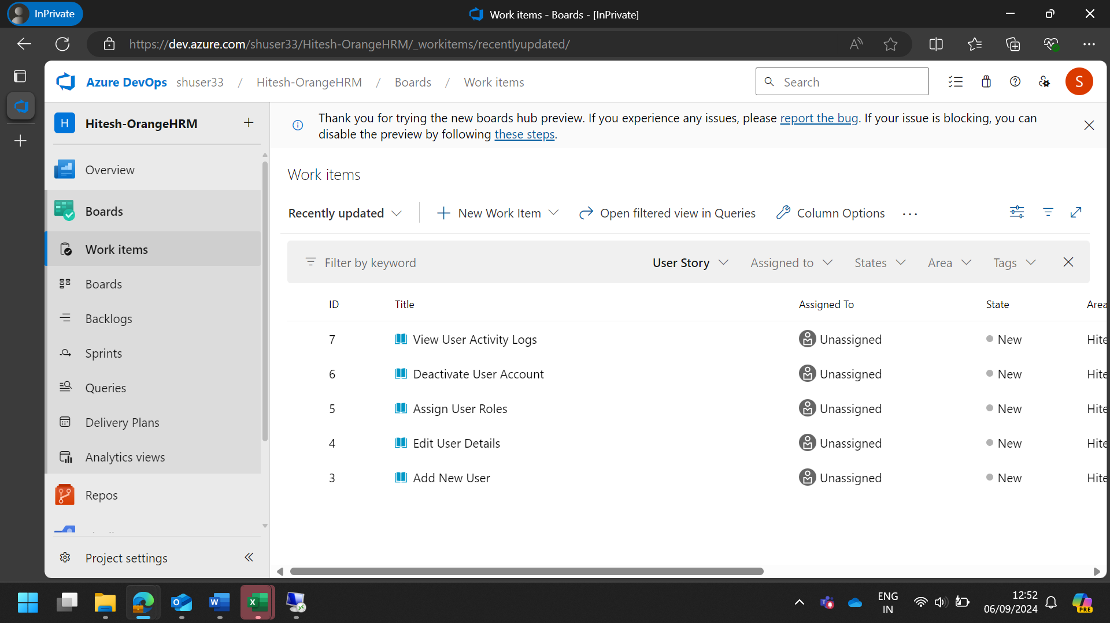
Learning 2 | My takeaways

Slide 6
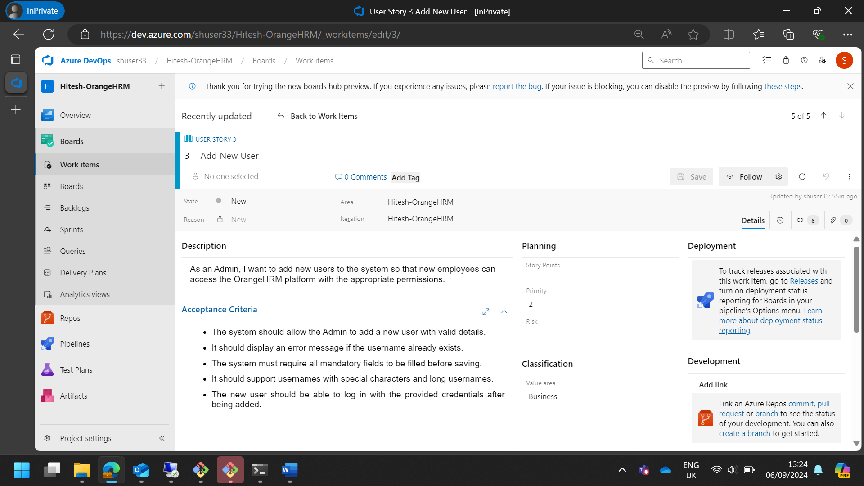
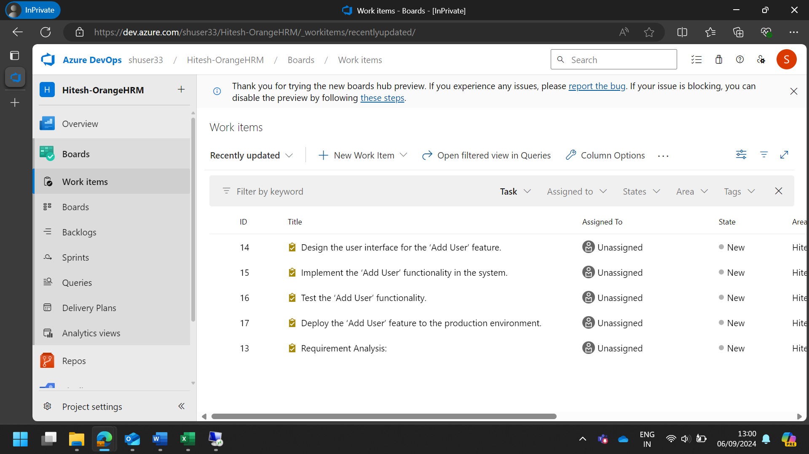
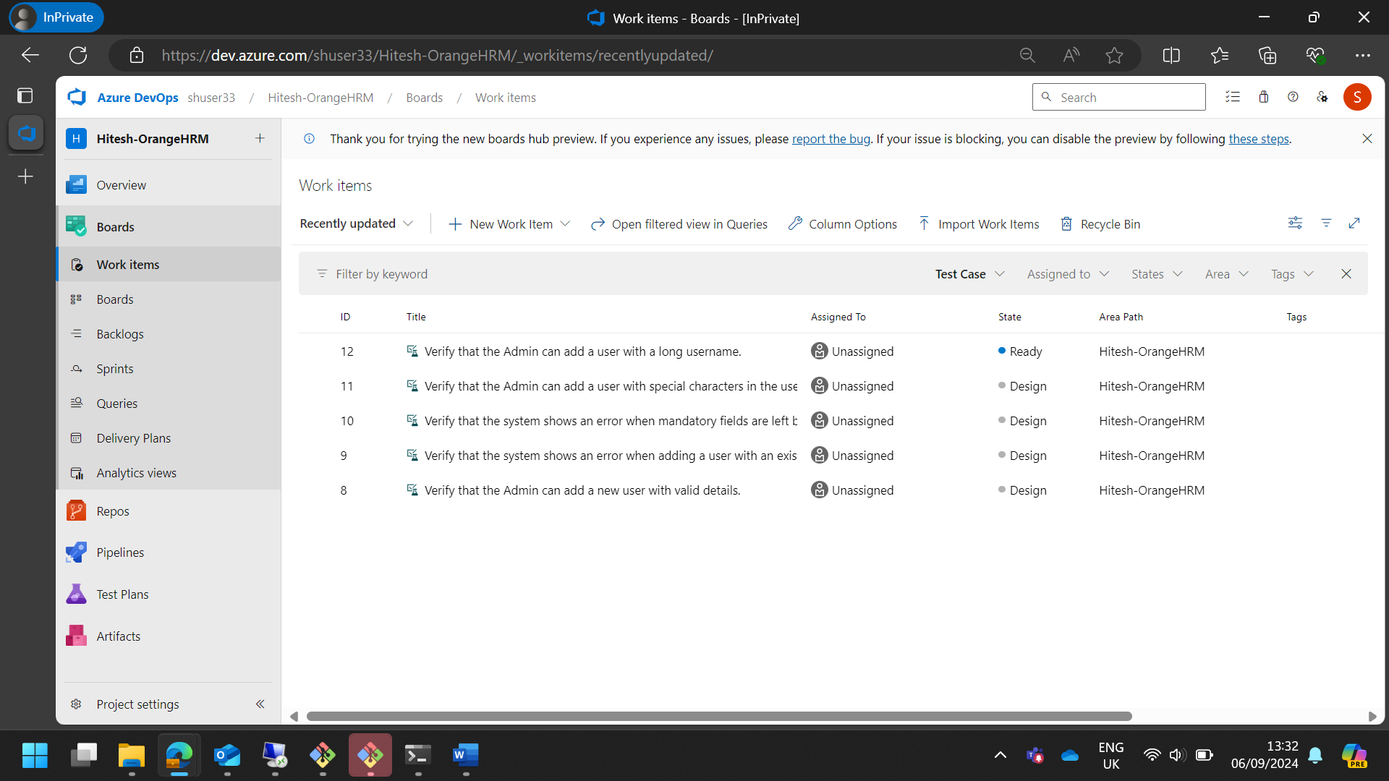
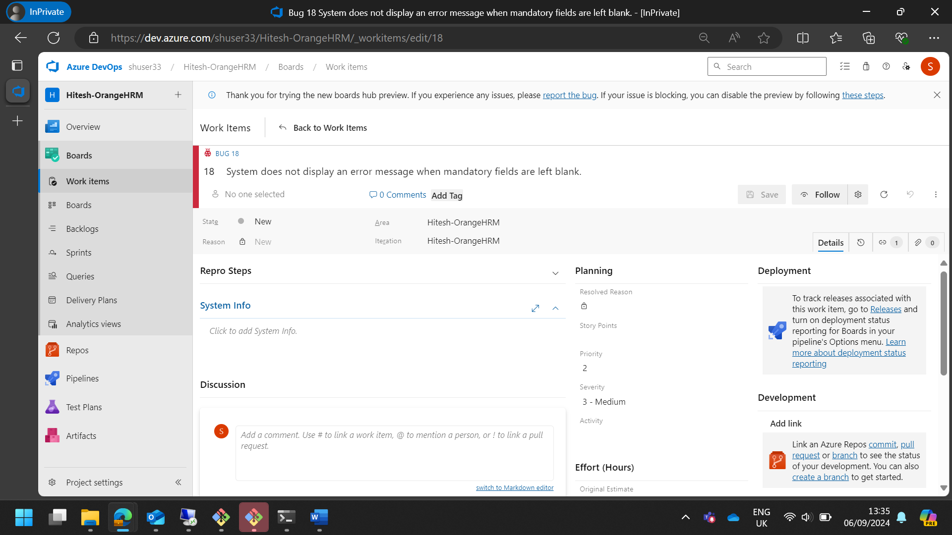
Learning 2 | My takeaways

Slide 7
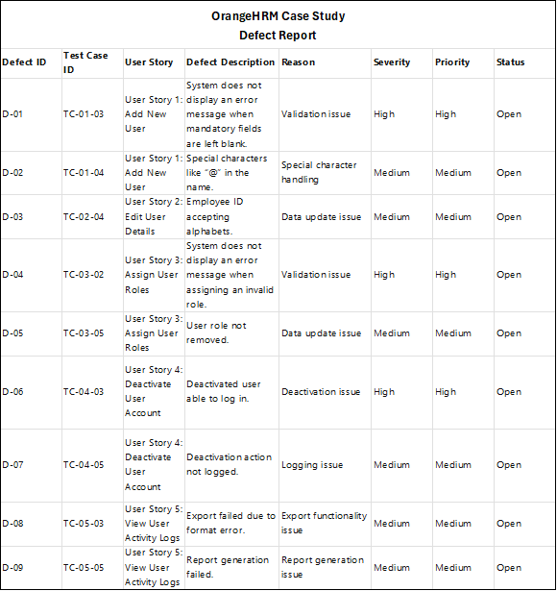
Learning 2 | My takeaways

Slide 8
Learning 3 | My takeaways
CI/CD Pipeline Implementation using GitHub Actions:
Repository Setup:
Created a new repository on GitHub and cloned the Java project codebase from the VM.
GitHub Actions Workflow:
Created a new Workflow on GitHub Actions for the Java/Maven code.
Monitored the build process.
Code Modification and Build Monitoring:
Modified code (e.g., Java class or pom.xml) to trigger Workflow and recheck the build.
Monitored the build results after committing changes.
Documentation and Reporting:
Uploaded screenshots of successful builds and committed them to the repository.
Added the created test cases report and defect report to the repository.

Slide 9
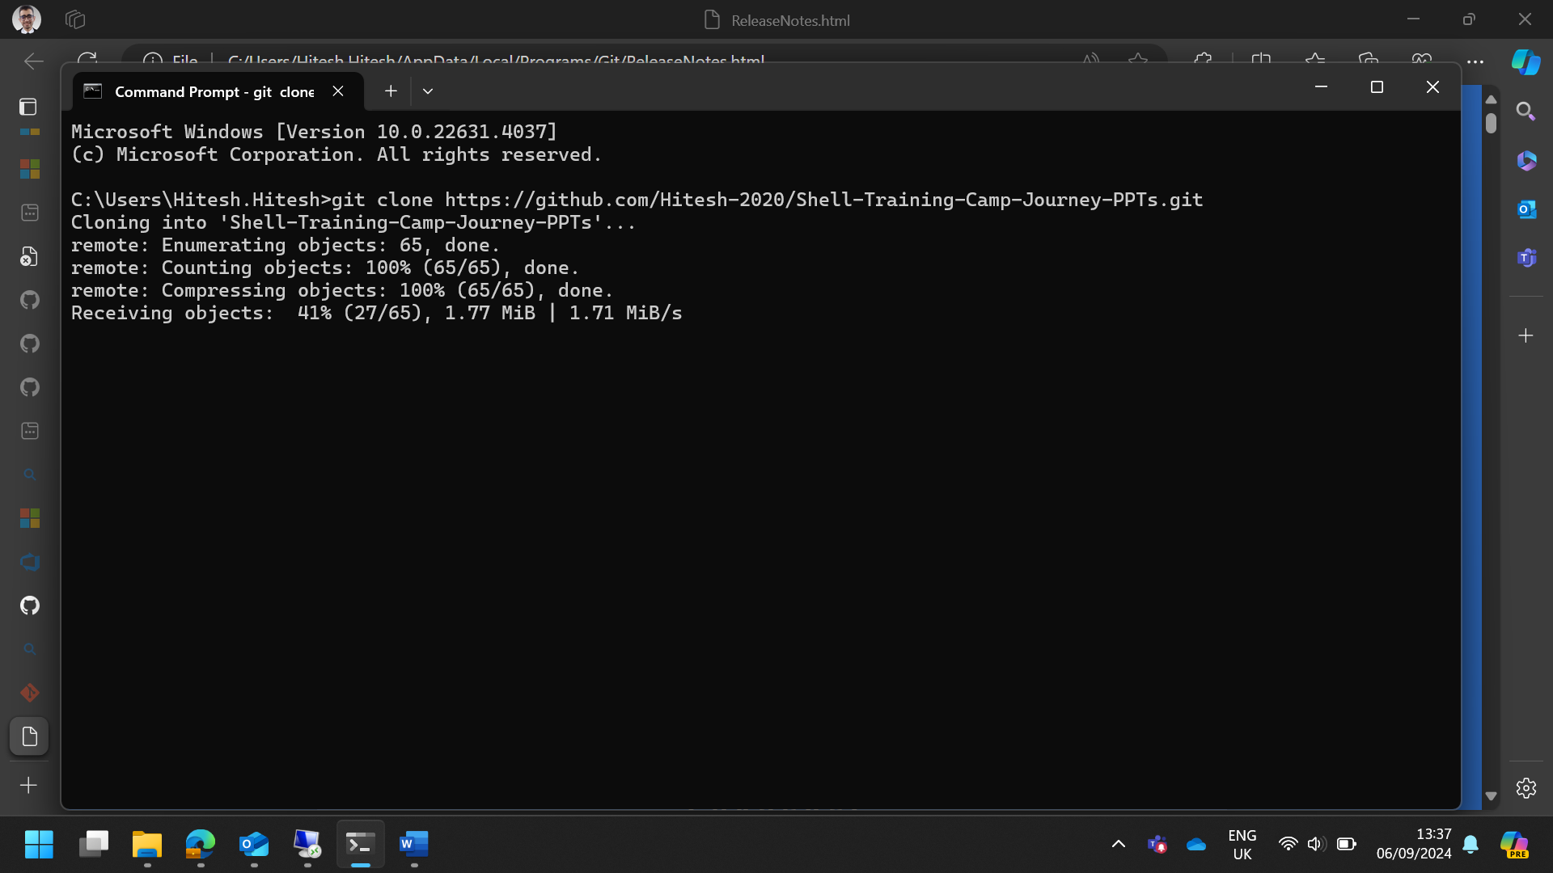
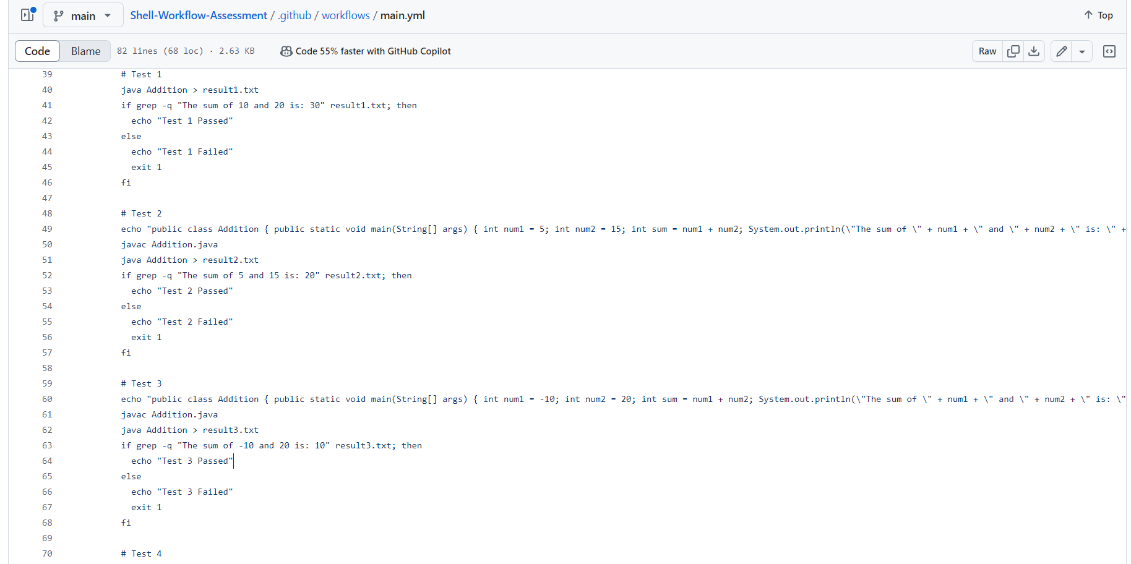
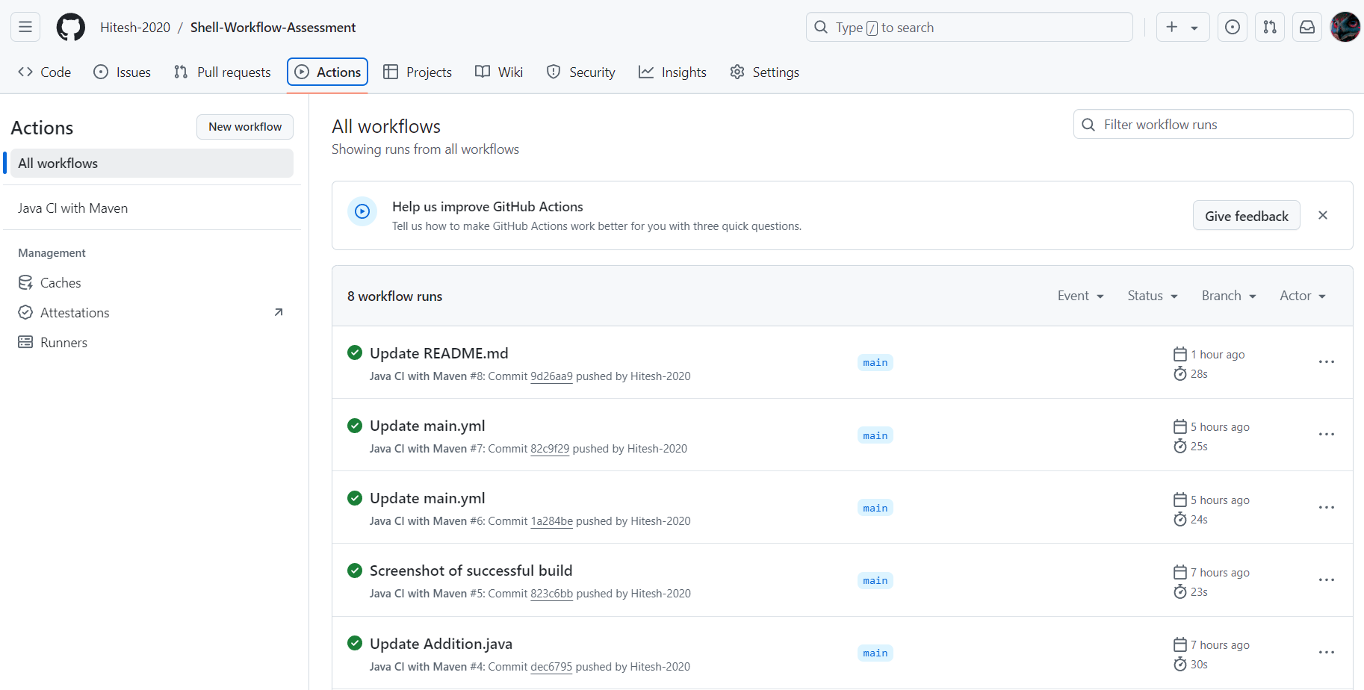
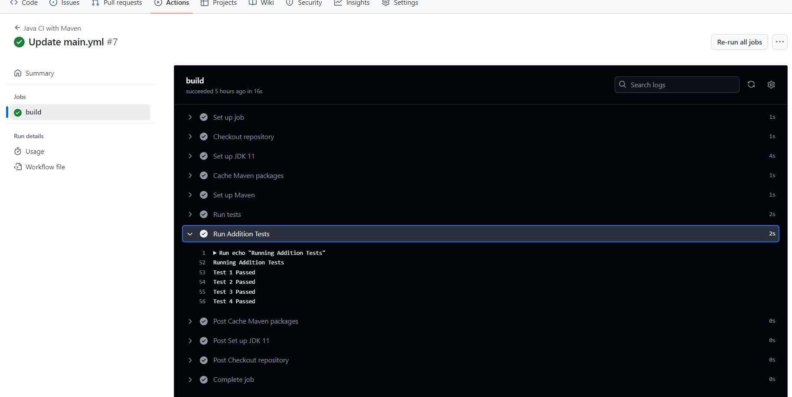
Learning 3 | My takeaways

Slide 10
Thank You

